Slide 1
E-COMMERCE
MODULE 4
B.Tech. CSE
Semester VIII
Viswajyothi College of Engineering

Slide 2
7. Internal Information Systems
Information usually begins with corporate data.
  Corporate data provide the building blocks to form the information and knowledge that underlie the operations of all enterprises.
Corporate information is created, managed and stored in many forms and places.
Proprietary Systems as Differentiators
In Old Paradigm, a proprietary infrastructure was put in place first and then the organization went beyond the technology to view the management of “infrastructure” itself as an asset to gain competitive advantage.
  Eg:- American Airlines selles its services to other airlines,which was not envisioned when the system was developed
A New Paradigm: Information Architecture
Cross-Functional Systems – emphasis on integrating the enterprise,with information flowing from one business area to another
Information Not Data –
  Use of corporate data
  Change in technology management area

Slide 3
8. Work-Flow Automation and Coordination
DEFINITION
A vision of speeding up or automating routine business tasks has come to be known as “work-flow automation”.
  This vision has its root in the invention of the assembly line and the application of Taylor's scientific management principles.
Automation of knowledge-based business processes are called work-flow automation.
The goal of work-flow automation is to offer more timely, cost-effective, and integrated ways to make decisions.
Typically, work-flows are decomposed into steps or tasks, which are task oriented to determine which should be done first, second and so on..

Slide 4
Work-flows can be simple or complex.
  Simple work-flows typically involve one or two steps or tasks.
    Eg:- Mail application which sorts mail
  Complex work-flows - involve several work-flows, some of which executes simultaneously.
    Eg:- Purchase order through approval process
  Another way of looking at work-flow is to determine the amount of cross-functional activity.
    Companies must adopt an integrated process view of all the business elements
Organizational integration is extremely complex and typically involves Three steps
Improving existing processes by utilizing technology where appropriate.
Integrate across the business function offer identifying the information needs for each process.
Integrating business functions, application program interface, and database across departments and groups.

Slide 5
Work-Flow Coordination:
The key element of market-driven business is the coordination of tasks and other resources throughout the company to create value for customer.
To this end, effective companies have developed horizontal structures around small multifunctional teams that can move more quickly and easily than businesses that use the traditional function-by-function, sequential approach.
Some of the simplest work-flow coordination tools are electronic forms routing applications such as lotus notes.
As the number of parties in the work flow increases, good coordination becomes crucial.
  To facilitate better work flow coordination, companies are using software agents

Slide 6
Work-flow related technologies:
Technology must be the “engine” for driving the initiatives to streamline and transform business interactions.
Large organizations are realizing that they have a middle-management vaccum after all the down sizing and reorganization of past few years.
  Middle managers know how to get things done
Pressures for more comprehensive work-flow systems are building rapidly.
Work-flow system are limited to factory like work process.
Focus on today’s realities and actual market trends
  Middleware is maturing – an environment in which other applications can be developed
  Organizational memory is becoming practical – corporate digital library : Information can be refined and used by different people

Slide 7
9. Supply Chain Management (SCM)
Supply chain network (network of partnerships) reduce costs and complement products with basic and value-added services.
Supply chain management (SCM) is an integrating process based on the flawless delivery of basic and customized services
SCM optimizes information and product flows from the receipt of the order, to purchase of raw materials, to delivery an consumption of finished goods.
SCM plays an important role in the management of processes that cut across functional and departmental and organizational boundaries, reaching out to suppliers and customers.

Slide 8
SCM is important in retailing because it helps manage the demand and supply functions.
In electronic commerce, SCM has the following characteristics :
An ability to source raw material or finished goods from anywhere in the world
A centralized, global business and management strategy with flawless local execution.
On-line, real-time distributed information processing to the desktop, providing total supply chain information visibility.
The ability to manage information not only within a company but across industries and enterprises.
The seamless integration of all supply chain processes and measurements, including third-party suppliers, information systems, cost accounting, standards, and measurement systems.
The development and implementation of accounting models link cost to performance are used as tools for cost reduction.

Slide 9
Two primary models of SCM: push versus pull.
Primary elements in these models are
Logistics and distribution (integrated logistics)
Purchasing
Integrated marketing and distribution
Agile manufacturing
Efficient consumer response

Slide 10
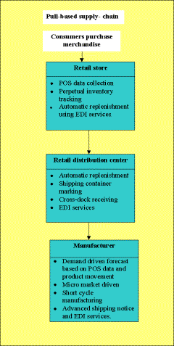
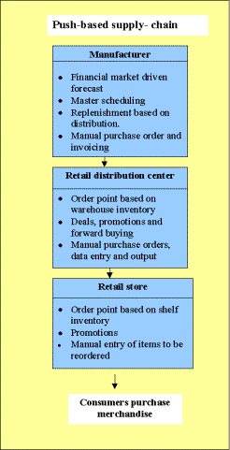
Push vs Pull

Slide 11
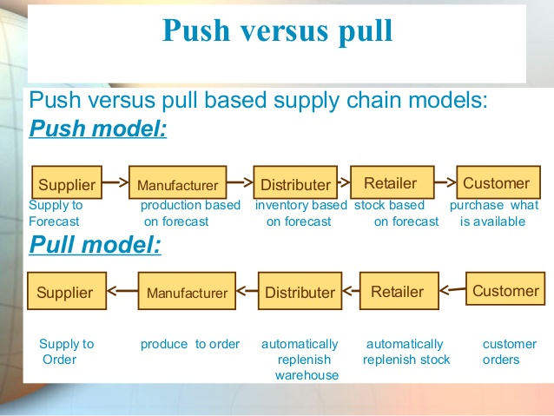
Purchasing

Slide 12
Logistics and distribution (integrated logistics)
Deals with management and physical distribution of raw materials, goods for sale and ware housing .
Integrated marketing and distribution
Marketing defines the way a company does business. Integrated marketing includes promotions, advertisement, sales. Marketing must integrate consumer to company
Efficient consumer response
The main purpose of ECR is to improve the performance of retail industry. It reduces the total cost by 10%. It does this by changing the way in which the products are purchased and concentrates on the continuous product replenishment (CPR).
ECR are responsible for
Analyzing the performance of standard products daily
Find upward trends and declines in the performance of products on regular basis
Renew the product whose performance is decreased.
Repairs errors and handle them.

Slide 13
Agile Manufacturing
Agility implies breaking out the mass-production mold and producing highly customized products - when and where the customer wants them. Agility also embodies such concepts as rapid formation of multi company alliances to introduce new products to the market.
Agility is essential in a future that requires new and innovative manufacturing, practices, among them the following:
Customers "custom design" products such as automobiles and clothing, electronically transmitting their requirements to remote locations capable of quickly manufacturing and distributing these products.
Companies rapidly and easily form alliances to produce new products.
Small and medium-sized companies advertise their manufacturing capabilities over computer networks and efficiently bid on projects required by other companies.
Software system brokers connect users who need temporary access to sophisticated manufacturing tools that would normally be too expensive to acquire.
Manufacturers and supplies use "intelligent" procurement systems for reducing costs, improving accuracy, and meeting customer demands in a timely manner.

Slide 14
There are various preconditions for success in an agile venture like
communication channels between involved parties.
predictability through management.
sensitivity to time.
The agile manufacturing enterprise seeks to achieve the following:
Greater product customization
Rapid introduction of new or modified products
Interactive customer relationships
Dynamic reconfiguration of production processes

Slide 15
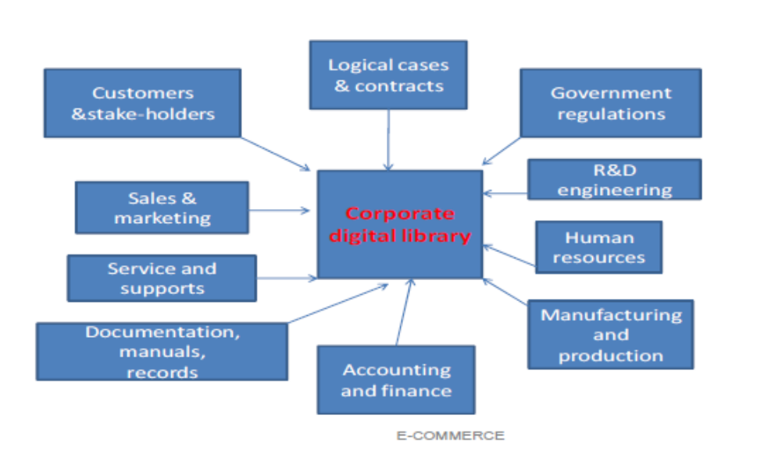
10. Document digital library
The term document is used to denote all non-data records I.e. books, reports, e-files, videos and audios.
Document library is simply a distributed network of interlinked information that is tailored for e-publishing
  Fig:- This section highlights the role that documents play in today’s organization and how business can better meet their customers’ needs by improving document management support.

Slide 16
11. Types of digital documents
Multimedia and other technologies for creation of documents
Framework for handling “data & applications” – these smart documents are called active documents
Imaging (TIFF)
Structured documents (SGML)
Distributed hypertext (HTML)
Active or Compound (OLE)

Slide 17
Document Imaging
An imaging system passes a paper document through a scanner that renders it digital & stores the digital data as a bit-mapped image.
Use key words for indexing & searching
Problems:
  Contains only images & not text
  No formal internal structure
  Does not allow repackaging – raw information needs to be packed/repacked fpr market/business
Imaging standards
  TIFF(Tag Image File Format) – for bitmap images - black & white images

Slide 18
Structured documents
Users can manipulate, edit and work with document content
Apply database structuring capabilities to documents to allow tools to manipulate document content
Documents may be lengthy, complex, spreadsheets, graphics etc.
  Example : TOC (Table Of contents)

Slide 19
Capabilities of structured documents
1. Document formatting & rendering
Companies give their CDs containing manuals to customers. This reduces printing & packaging costs and faster updates of critical information
Audio rendering of documents opens up a new world for visually handicapped.
2. Create easily modifiable structures
Allows more dynamic documents, user interaction & manipulation (bookmark, highlight text, write notes)
Documents can be edited, linked to other items such as graphics, video, photo etc.
3. Easier to search & query given the right structure & interface
String searches are possible

Slide 20
Formats:
Document interchange formats
(ODA - Office Document Architecture, CDA - Compound Document Architecture)
Adv:
Generate platform & application independent info
Keep format & styling
Support audio, graphics & video
Disadv:
Require expertise to use
Formats make users dependent on applications that can recognize the encoding used

Slide 21
(ii) Document structure languages (SGML – Standard Generalized Markup Language)
Adv:
Allows creation of document type definition
Disadv:
Does not support non-text elements

Slide 22
Hypertext documents
Hypertext makes document based information more mobile.
Reasons for mobility of info:
  Info in enterprise is located in server but distributed throughout the organization
  Split the large document into smaller pieces
  Reuse document fragments for composing new documents
Relationships between documents can be represented using hyperlinks

Slide 23
Active Documents
Provide interactive interface - Focus on task and not non-task related items.
  Non-task : Storage,data formats ets
Allow business teams to develop & interchange information
Combine composition of info with the distributed nature of info
  Composite – different media
  Distributed – Table value in a cell will change the drawing in excel
Allow users to create interfaces that are dynamically updated from remote data & computation objects that may be stored in the document libraries on the n/w
Examples:- OLE , CORBA

Slide 24
12.Corporate Data Warehouses
Data warehouse is used store information of the organization.
  Data warehouse is needed as enterprise wide due to increase in data volume and complexity.
Characteristics of data warehouse are:
  Information-based approach for decision making
  Involvement in highly competitive, rapidly changing markets with a large customer base for a variety of products
  Data stored in many systems and represented differently
  Data stored in complex, technical,formats making conversion for analysis difficult
Functions performed by data warehouse are:
  Allows existing transaction and legacy systems to continue in operation
  Consolidates data from the various transaction systems into a coherent set
  Allows analysis of vital information about current operations for decision support.

Slide 25
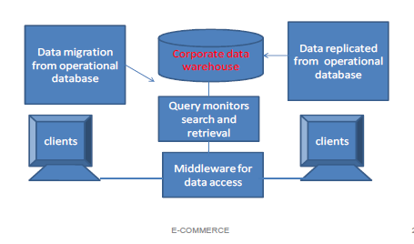
Types of Data warehouses
  Physical Data warehouse – Database, schema and processing logic
  Logical data warehouse - Metadata ,business rules and processing logic
  Data Library (Data Mart) – Department wise data warehouse.
  Subset of enterprisewide datawarehouse
  Decision Support Systems (DSS) – Applications that make use of datawarehouses
Building an End-to-end Data Warehouse
Back End
Preparing data for analysis
Front end

Slide 26
Back end : Building a data warehouse
Access operational data from wherever the information resides – for placement in repository
The data can be loaded into another database for information access
The data can be accessed where they reside on the legacy or operational database
Managing data
To manage data fallowing steps are needed:
  Translation – From different applications
  Summarizing – views for managers
  Packaging – Eg:- spreadsheets
  Distributing – To different groups
  Garbage collection – Remove useless data
Exploiting data : The front end
  User retreival
  Proactive delivery -

Slide 27
Advantages of data warehouse:
  Timely and accurate information become an integral part of the decision-making process.
  User can manage and access large volumes of in one cohesive framework.
  Data warehousing has wide spread applicability.
    It provides point-of-sales reports instead of end-of –day reports.

